Slide 1
Chemistry – Feb 6, 2020
P3 Challenge –
What type of bond will form between P and S, ionic, nonpolar or polar? Show your work.
Objective –
Covalent Lewis Structures
Assignment:
Lewis Structures Worksheet
Study for Polyatomic ion practice quiz on Monday
Agenda
Polyatomic ion quiz
Covalent Lewis Structures
Practice
Polyatomic Ions
Isomers
Polymers

Slide 2
Writing Covalent Lewis Structures
Find the sum of valence electrons of all atoms in the polyatomic ion or molecule.
If it is an anion polyatomic ion, add one electron for each negative charge.
If it is a cation polyatomic ion, subtract one electron for each positive charge.
The central atom is the least electronegative element that isn’t hydrogen. Connect the outer atoms to it by single bonds.
Fill the octets of the outer atoms.
Fill the octet of the central atom.
If you run out of electrons before the central atom has an octet…
…form multiple bonds until it does.
If you have extra electrons…
…place them on the central atom, if it has d orbitals accessible, Z>10.

Slide 3
Example
Find the sum of valence electrons of all atoms in the polyatomic ion or molecule.
If it is an anion, add one electron for each negative charge.
If it is a cation, subtract one electron for each positive charge.
PCl₃
Keep track of the electrons:
5 + 3(7) = 26

Slide 4
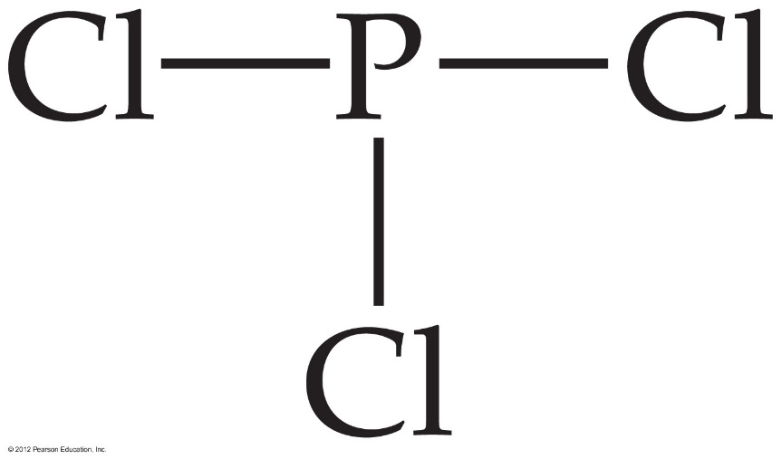
Writing Lewis Structures
The central atom is the least electronegative element that isn’t hydrogen. Connect the outer atoms to it by single bonds.
Keep track of the electrons:
26 − 6 = 20

Slide 5
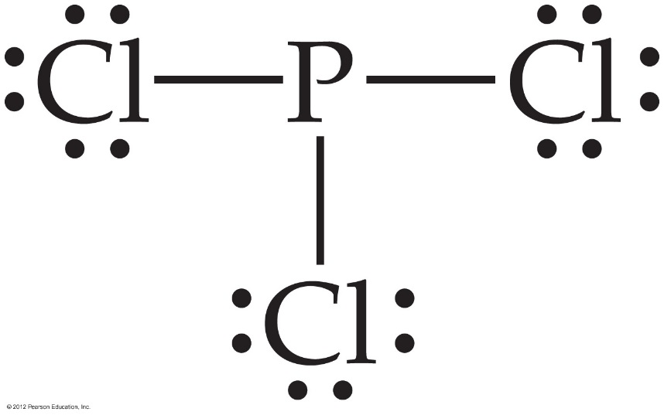
Writing Lewis Structures
Fill the octets of the outer atoms.
Hydrogen only gets a doublet.
The two electrons in the bond to H are all it can manage.
Never put extra electrons on H.
Keep track of the electrons:
26 − 6 = 20; 20 − 18 = 2

Slide 6
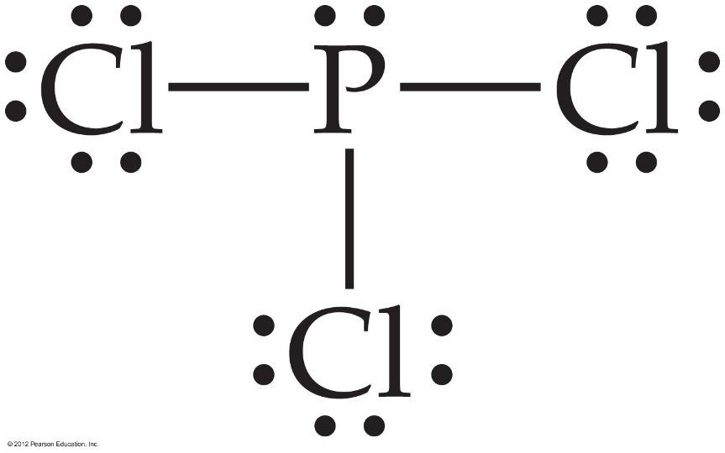
Writing Lewis Structures
Fill the octet of the central atom.
Keep track of the electrons:
26 − 6 = 20; 20 − 18 = 2; 2 − 2 = 0

Slide 7
Writing Lewis Structures
If you run out of electrons before the central atom has an octet…
Ex: HCN 1 + 4 + 5 = 10 electrons, C is least elecneg, 4 bonding, complete outer octet on N uses all electrons, C only has 4 electrons.
…form multiple bonds until it does.
Ex: two sets of nonbonding electrons swing in to become bonding.

Slide 8
Writing Lewis Structures
If you have extra electrons…
Ex: SF₄ , 6 + 4(7) = 34 electrons, Sulfur central, four bonds to F use 8 electrons. Complete octets with 6 nonbonding on each F, uses 24 electrons. 2 electrons are left over even though all atoms have an octet.
…place them on the central atom, if it has d orbitals accessible, Z>10.
Ex: S has Z = 16, so it has d orbitals it can use. Place the extra two electrons on the sulfur atom as a nonbonding pair. This is called and expanded octet

Slide 9
Practice Writing Lewis Structures
CH₄
PO₄⁻³
NH₄⁺
SiO₂

Slide 10
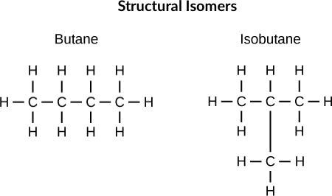
Isomers
When there is more than one way for the same set of atoms to be connected, the different possibilities are called isomers.
Isomers will have the same chemical formula but different Lewis structures
Ex: 2 Isomers of C₄H₁₀

Slide 11
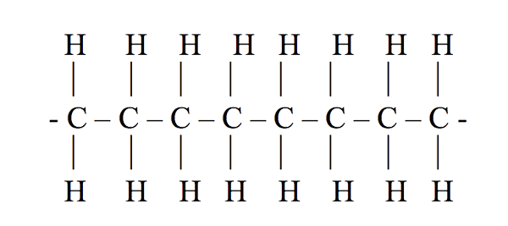
Polymers
A compound with a repeating simple unit is called a polymer. The simple unit is called the monomer.
Ex: Polyethene
Nearly all plastics are polymers.
Nearly all biological molecules are polymers.
Carbohydrates, Proteins, DNA

Slide 12
Exit slip and Homework
Exit Slip: Determine the Lewis Structure for the sulfate ion.
What’s Due? (Pending assignments to complete.)
Complete the Lewis Structures Worksheet
Study for Polyatomic ion quiz on Tuesday
What’s Next? (How to prepare for the next day)
Read p194-198

